Slide 1
Dijkstra's Algorithm

Slide 2

Introduction to Dijkstra's
Algorithm
In this presentation, we will explore Dijkstra's Algorithm, a powerful method for ﬁnding the shortest path in graphs.
This algorithm is widely used in various applications, from GPS navigation to network routing. Join us as we unravel its intricacies and real-world signiﬁcance!

Slide 3
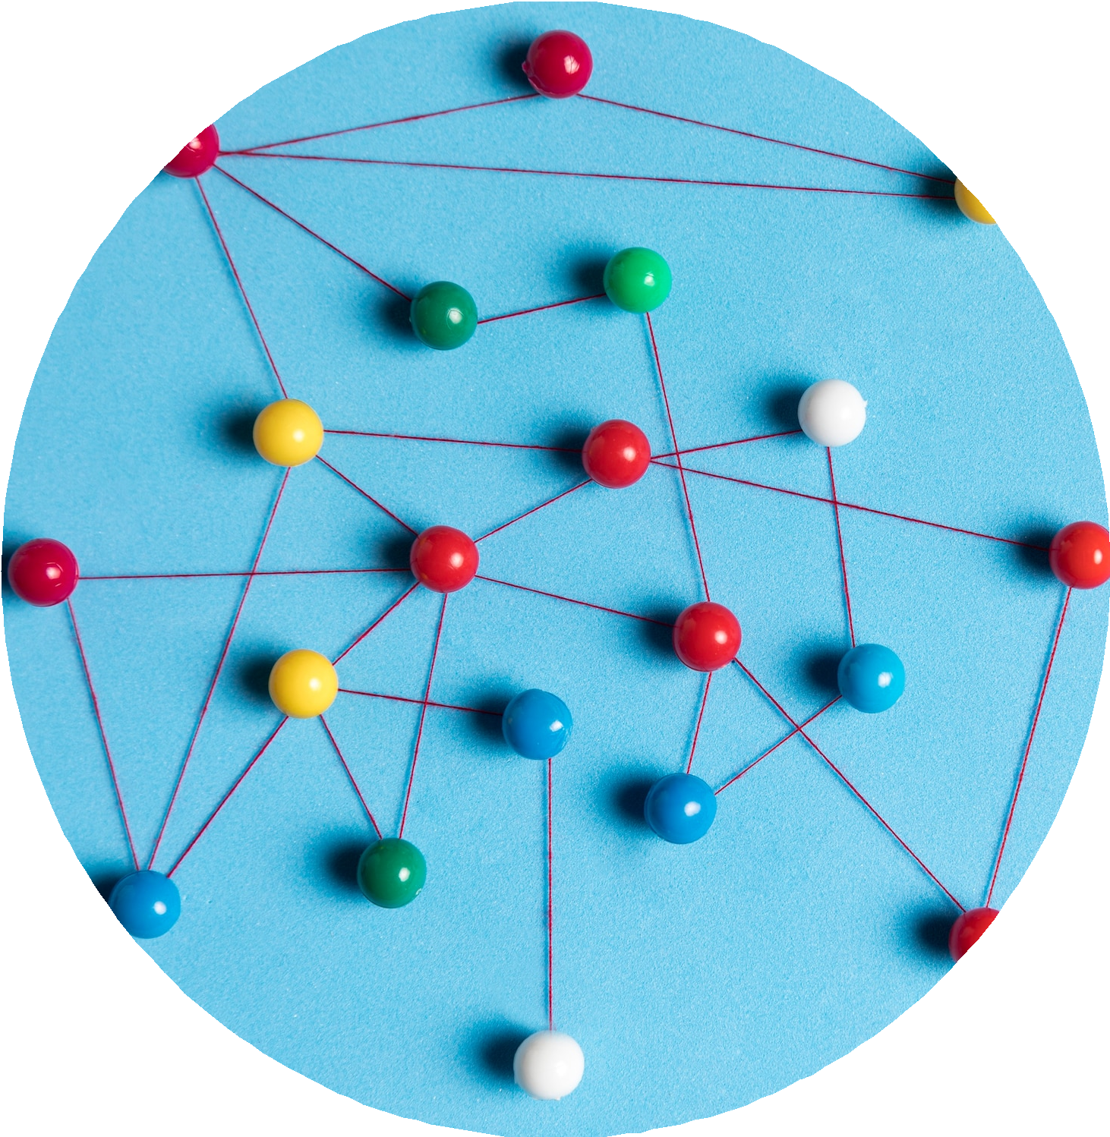
Understanding Graphs
Graphs are composed of nodes (or vertices) and edges that connect them. They can represent various structures like cities connected by roads.
Understanding how to model problems using graphs is essential for applying Dijkstra's Algorithm eﬀectively in real-world scenarios.

Slide 4

How Dijkstra's Algorithm Works
Dijkstra's Algorithm operates by iteratively selecting the closest node not yet processed and updating the distances to its neighbors. This process continues until all nodes have been evaluated, ensuring the shortest path is found eﬃciently. It's a blend of greedy and dynamic programming techniques.

Slide 5

Applications of Dijkstra's Algorithm
Dijkstra's Algorithm is utilized in various ﬁelds, such as GPS navigation, network routing, and even in robotics for pathﬁnding. Its ability to ﬁnd optimal paths makes it invaluable in scenarios where eﬃciency is crucial. Let's explore some real-world applications!

Slide 6
Conclusion: The Power of Dijkstra
In conclusion, Dijkstra's Algorithm is a fundamental tool in computer science for solving shortest path problems. Its applications are vast and its eﬃciency makes it a go-to choice for many scenarios. Embracing this algorithm opens doors to innovative solutions in various ﬁelds.

